Slide 1
Adversary game Research

Slide 2
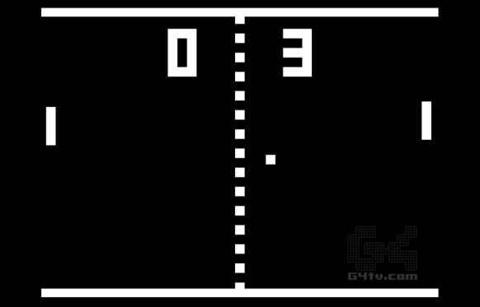
Pong
What makes the adversary in Pong fun: initiates a competitive user experience. This can be boiled down to the score counting mechanic. Players play against each other to get the highest score.
Competition encourages an addictive experience for players.
This isn’t exclusive to neither turn based and real-time gameplay.

Slide 3
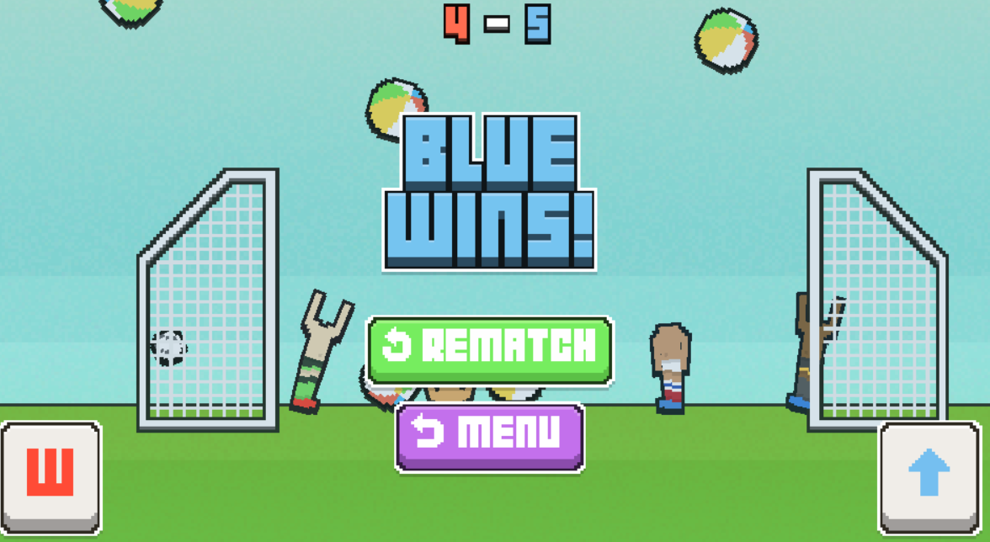
Soccer Physics
Much like Pong the adversary game play style evident in Soccer Physics steams from the Score collecting mechanic.
From research it is evident to say that collecting and keeping score is at the heart of every adversary game.
In order to innovate, a fresh take on the score collecting mechanic most be approached..

